Slide 1
Knowledge Engineering
21.09.2019

Slide 2
Introduction to Knowledge Engineering
Knowledge Engineering - Natig Vahabov

Slide 3
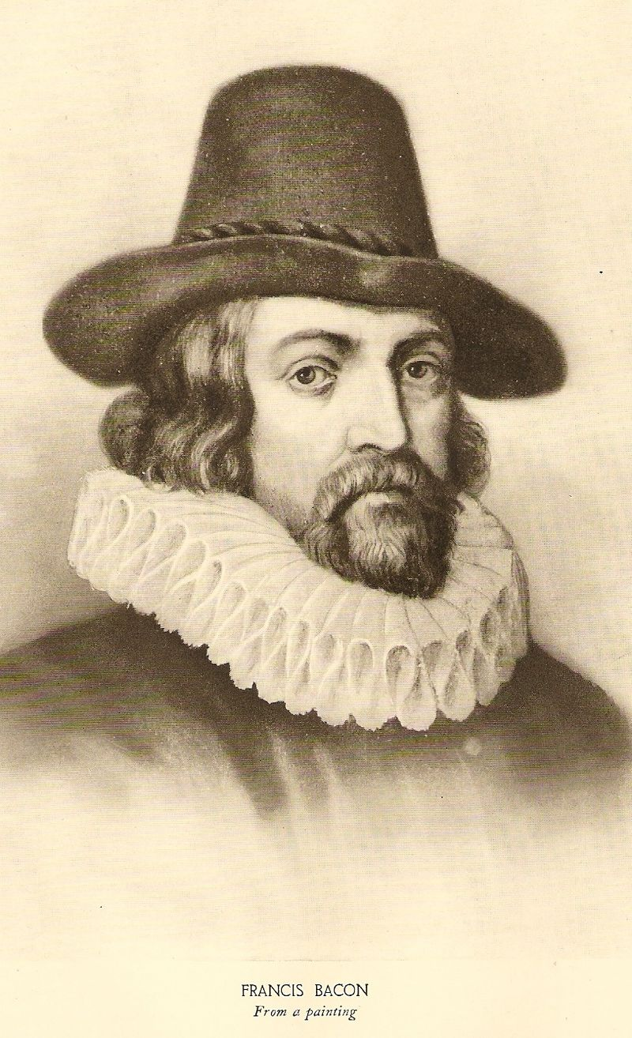
scientia potentia est
“Knowledge is power”
Sir Francis Bacon, 16th century
English philosopher
Knowledge Engineering - Natig Vahabov

Slide 4
Agenda
Knowledge as a weapon
Knowledge pyramid
Information Processing Views of Knowledge
Philosophy of knowledge
  Plato’s Formula, Gettier Problem
Taxonomies of knowledge
  Types, Classifications, Levels
Knowledge Creation
  SECI Model
Knowledge Engineering
  History, MYCIN, KBS, Knowledge Steps, FOL, Semantic Network, Views
CommonKADS
Roles in Knowledge Engineering
Knowledge Engineering - Natig Vahabov

Slide 5
Knowledge as a weapon
In 2017, China’s government put out its plan to lead the world in AI by 2030
By the end of 2019, with a $14 trillion GDP(gross domestic product), China is predicted to account for over 35 % of global economic growth. AI’s deployment will add $15.7 trillion to the global GDP by 2030.
What are 4 main factors help China to become a world giant?
Knowledge Engineering - Natig Vahabov

Slide 6
Knowledge as a weapon
Mass government funding and support
  Government have already spent more than $300 billion
Knowledge Engineering - Natig Vahabov

Slide 7
Knowledge as a weapon
Mass government funding and support
  Government have already spent more than $300 billion
Hungry entrepreneurs
  AI giant Alibaba has unveiled plans to invest $15 billion in international research labs from the US to Israel, with others following suit
Knowledge Engineering - Natig Vahabov

Slide 8
Knowledge as a weapon
Mass government funding and support
  Government have already spent more than $300 billion
Hungry entrepreneurs
  AI giant Alibaba has unveiled plans to invest $15 billion in international research labs from the US to Israel, with others following suit
Growing AI expertise
  Meanwhile, Baidu, Didi, and Tencent have all set up their own research labs. China’s Face++ now leads the world in face and image recognition AI, beating out top teams from Google, Microsoft and Facebook at the 2017 COCO image-recognition competition
Knowledge Engineering - Natig Vahabov

Slide 9
Knowledge as a weapon
Mass government funding and support
  Government have already spent more than $300 billion
Hungry entrepreneurs
  AI giant Alibaba has unveiled plans to invest $15 billion in international research labs from the US to Israel, with others following suit
Growing AI expertise
  Meanwhile, Baidu, Didi, and Tencent have all set up their own research labs. China’s Face++ now leads the world in face and image recognition AI, beating out top teams from Google, Microsoft and Facebook at the 2017 COCO image-recognition competition
Abundant Data
Knowledge Engineering - Natig Vahabov

Slide 10
Knowledge as a weapon
Abundant Data
- Government prohibited to use of west world social medias.
- WeChat platform alone has over one billion monthly active users. That’s more than the entire population of Europe.
- Chinese AI giants like Tencent have created unified online ecosystems that concentrate all your data in one place.
- China’s facial recognition capacities explode, these maps are increasingly populated with faces even when you’re not online.
- Chinese mobile payments exceeded $9 trillion just in 2016
- Mobile payment platforms like WeChat Wallet and Alipay have data on everything
Knowledge Engineering - Natig Vahabov

Slide 11
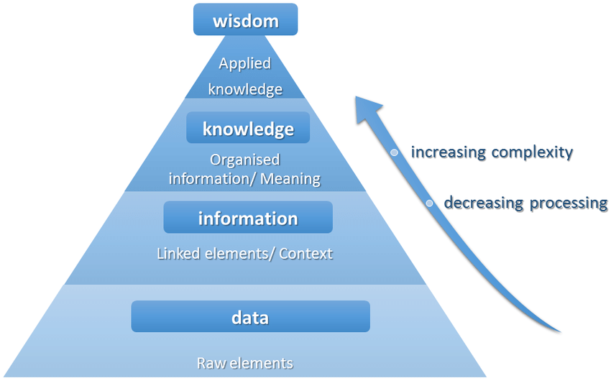
Knowledge pyramid
Knowledge Engineering - Natig Vahabov

Slide 12
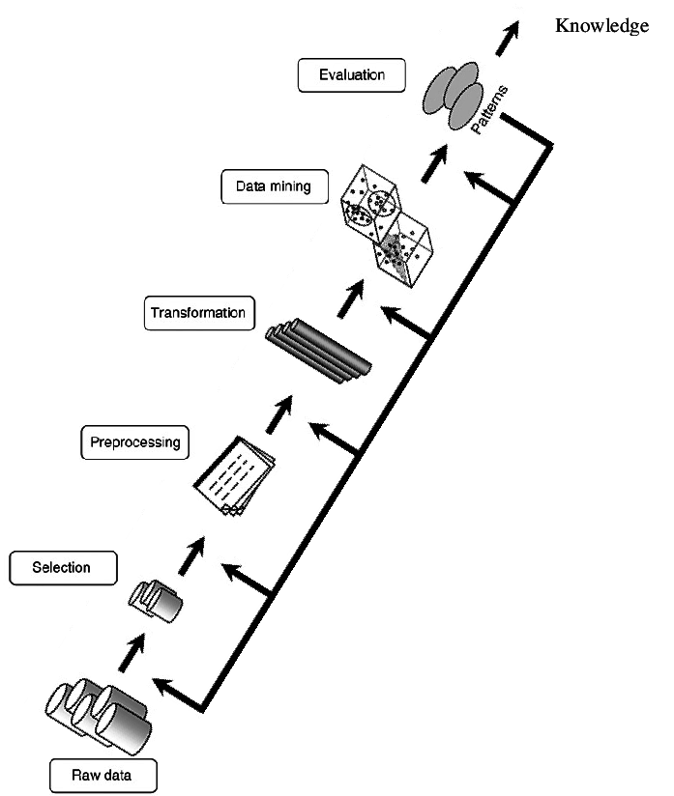
Raw data to knowledge
Knowledge Engineering - Natig Vahabov

Slide 13
Information Processing Views of Knowledge
Hierarchical view
Reversed hierarchical view
Non-hierarchical view
Knowledge Engineering - Natig Vahabov

Slide 14
Information Processing Views of Knowledge
Hierarchical view
  Information is the input or raw material of new knowledge
  Knowledge is authenticated/personalized information
Knowledge Engineering - Natig Vahabov

Slide 15
Information Processing Views of Knowledge
Reversed hierarchical view
  Knowledge must exist before information can be formulated and before data can be collected
Knowledge Engineering - Natig Vahabov

Slide 16

Information Processing Views of Knowledge
Non-hierarchical view
  Knowledge is needed in converting data into information
  Knowledge is the accumulation of experiences and knowledge is created through conjectures and refutations.
Knowledge Engineering - Natig Vahabov

Slide 17
Philosophy of knowledge
‘Knowledge is a familiarity, awareness, or understanding of someone or something, such as facts, information, descriptions, or skills, which is acquired through experience or education by perceiving, discovering, or learning’.
Wikipedia
Knowledge Engineering - Natig Vahabov

Slide 18
Philosophy of knowledge
In philosophy, the study of knowledge is called epistemology
The philosopher Plato defined knowledge as ‘justified true belief’.
Can we formulate knowledge?
Knowledge Engineering - Natig Vahabov

Slide 19
Philosophy of knowledge
Person knows that Subject
If and only if
S is TRUE
P BELIVES that S is TRUE
P is JUSTIFIED in BELIEVING that S is TRUE
This is formula according to Plato, but is it totally accurate?
Knowledge Engineering - Natig Vahabov

Slide 20
Philosophy of knowledge
American Philosopher Edmund Gettier, in 1963 introduced three-page paper with two counterexamples against Plato JTB statement.
One of Gettier Problem is:
if P looks at the clock which just stopped working few days ago, but shows the correct time, then does it mean P knows S?
Knowledge Engineering - Natig Vahabov

Slide 21
Philosophy of knowledge
Person knows that Subject
If and only if
S is TRUE
P BELIVES that S is TRUE
P is JUSTIFIED in BELIEVING that S is TRUE
It is ON TRUE GROUNDS that P BELIEVES that S
Knowledge Engineering - Natig Vahabov

Slide 22
Taxonomies of Knowledge
Six Types of Knowledge
Meta-knowledge
  Knowledge about knowledge
Declarative knowledge
  Know-about
Procedural knowledge
  Know-how
Causal knowledge
  Know-why
Conditional knowledge
  Know-when
Relational knowledge
  Know-with
Knowledge Engineering - Natig Vahabov

Slide 23
Taxonomies of Knowledge
Knowledge can be classified as:
Tacit vs. explicit
  Tacit knowledge is deeply rooted in actions, experience, and involvement in a specific context. On the other hand, Explicit knowledge refers to knowledge that is transmittable in formal, systematic language.
Theoretical vs. practical
Individual vs. social
  Individual knowledge is created by and exists in the individual whereas social knowledge is created by and exists in the collective actions of a group.
Knowledge Engineering - Natig Vahabov

Slide 24
Knowledge Levels
Shallow knowledge
  A representation of only surface level information that can be used to deal with very specific situations
  For example
  “If gasoline tank is empty, then car will not start “
Deep knowledge
  A representation of information about the internal and causal structure of a system that considers the interactions among the system’s components
Knowledge Engineering - Natig Vahabov

Slide 25
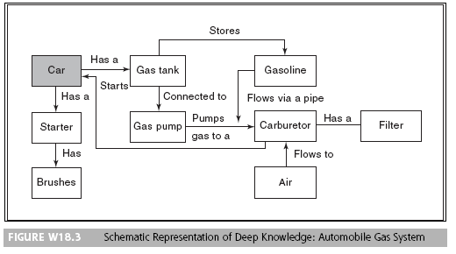
Deep Knowledge Example
Knowledge Engineering - Natig Vahabov

Slide 26
Knowledge Creation
Knowledge Creation is process to create new ideas through interactions between explicit and tacit knowledge in individual human minds.
Knowledge sharing and knowledge creation are the two vital aspects of knowledge management which play an important role in creating organisational value.
Ikujiro Nonaka introduced SECI Model in 1990 and Takeuchi developed it, to share, spread and create new knowledge.
Knowledge Engineering - Natig Vahabov

Slide 27
SECI Model (Nonaka and Takeuchi, 1990)
Socialization
  This dimension explains Social interaction as tacit to tacit knowledge transfer, sharing tacit knowledge face-to-face or through experiences
Externalization
  Tacit and explicit by Externalization (f.e. publishing) that embed the combined tacit knowledge which enable its communication
Combination
  Explicit to explicit by Combination (f.e. organizing), combining different types of explicit knowledge to, for example building prototypes
Internalization
  Explicit to tacit by Internalization, explicit knowledge becomes part of an individual's knowledge and will be assets for an organization
Knowledge Engineering - Natig Vahabov

Slide 28
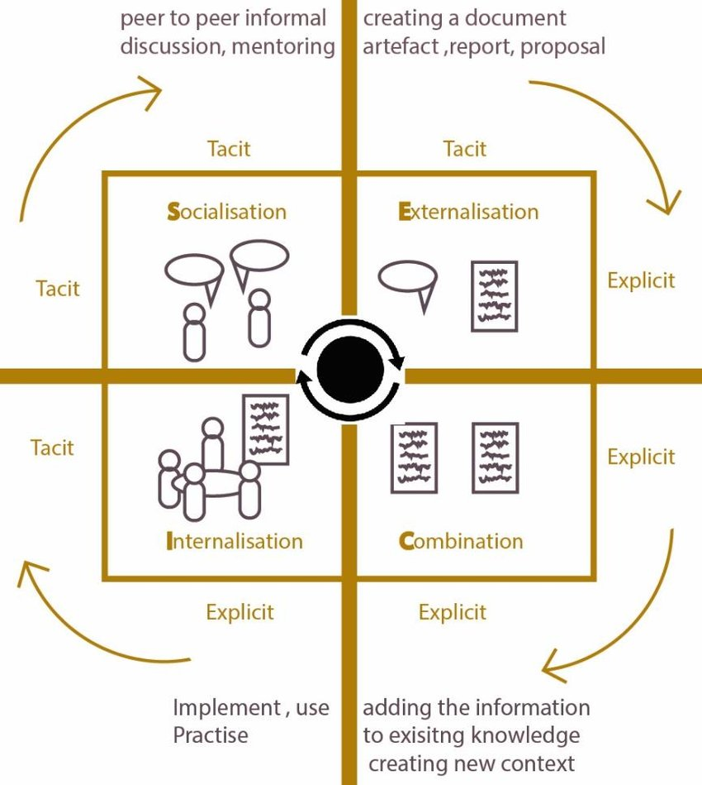
The SECI Model
Knowledge Engineering - Natig Vahabov

Slide 29
Knowledge Engineering
An engineering discipline that involves integrating knowledge into computer systems in order to solve complex problems normally requiring a high level of human expertise
Feigenbaum and Pamela, 1983
Knowledge Engineering - Natig Vahabov

Slide 30
Knowledge Engineering
Knowledge engineering (KE) refers to all technical, scientific and social aspects involved in building, maintaining and using knowledge-based systems (KBS)
Knowledge Engineering - Natig Vahabov

Slide 31
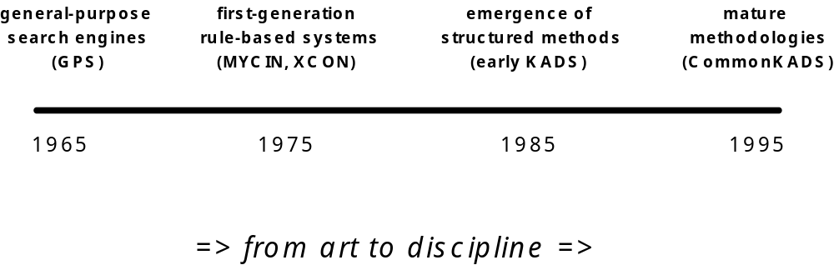
A Short History of
Knowledge Systems
Knowledge Engineering - Natig Vahabov

Slide 32
MYCIN
Diagnosing and treating patients with infectious blood diseases
A rule-based expert system
Developed at Stanford University – 1976
Uses backward chaining for reasoning
Incorporates about 500 rules
Written in INTERLISP (a dialect of LISP)
Knowledge Engineering - Natig Vahabov

Slide 33
Knowledge Engineering
It normally involves five distinct steps in transferring human knowledge into some form of knowledge based systems (KBS)
  Knowledge acquisition
  Knowledge validation & verification
  Knowledge representation
  Inferencing
  Explanation and justification
Knowledge Engineering - Natig Vahabov

Slide 34
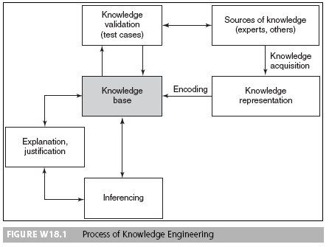
Knowledge Engineering
Knowledge Engineering - Natig Vahabov

Slide 35
Knowledge Acquisition
Knowledge acquisition is the process of extracting, structuring and organizing knowledge from one source, usually human experts so it can be used in software such as an Expert System. This is often the major obstacle in building an Expert System.
Source can be:
Human Experts, Databases, Internet
  Undocumented knowledge
Expert Systems
  Documented knowledge
Knowledge Engineering - Natig Vahabov

Slide 36
Knowledge Acquisition Techniques
Interview
  Most knowledge is in the head of the experts, they have lots tacit knowledge and tacit knowledge is hard to describe. Don’t expect an expert must know everything
  There are certain problems: not interested, unavailable, too theoretical etc.
Self-report
Laddering
  Organizing entities in a hierarchy ( For example, Office room allocation due to profession, gender, smoker, location etc.)
Card Sorting
  Write down key concepts in various cards and let expert cluster them in a way.
Diagram-based techniques
  Let expert explain tacit knowledge with preferred diagrams, such as UML
Knowledge Engineering - Natig Vahabov

Slide 37
Knowledge V&V
Knowledge acquired from experts needs to be evaluated for quality, including:
  The main objective of evaluation is to assess an ES’s overall value
  Validation is the part of evaluation that deals with the performance of the system
  Verification is building the system right or substantiating that the system is correctly implemented to its specifications
Knowledge Engineering - Natig Vahabov

Slide 38
Knowledge Representation
Logical Representation
  Represent knowledge with mathematical logic
  First Order Logic, Propositional Logic
Production Rule
  A knowledge representation method in which knowledge is formalized into rules that have IF and THEN parts
Semantic Network
  A knowledge representation method that consists of a network of nodes, representing concepts or objects, connected by arcs describing the relations between the nodes
Frames
Knowledge Engineering - Natig Vahabov

Slide 39
Knowledge Representation - FOL
First-order logic (like natural language) assumes the world contains
  Objects: people, houses, numbers, colors..
  Relations: red, prime, brother of, bigger than..
  Functions: father of, best friend, plus..
“All professors are people”
∀ x ( is-prof(x) → is-person(x) )
“Everyone is a friend of someone”
∀ x (∃ y ( is-friend-of (y, x) ) )
Knowledge Engineering - Natig Vahabov

Slide 40
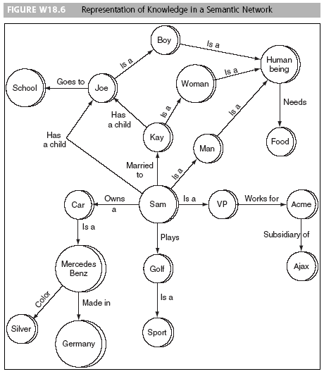
Knowledge Representation – Semantic Network
Semantic network is a knowledge representation method that consists of a network of nodes, representing concepts or objects, connected by arcs describing the relations between the nodes
Knowledge Engineering - Natig Vahabov

Slide 41
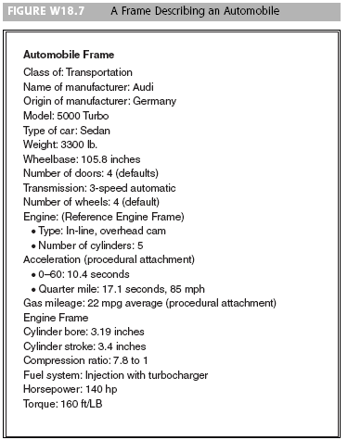
Knowledge Representation – Frames
Frames is a knowledge representation scheme that associates one or more features with an object in terms of slots and particular slot values
Knowledge Engineering - Natig Vahabov

Slide 42
Inferencing
This activity involves the design of software to enable the computer to make inferences based on the stored knowledge and the specifics of a problem. The system can then provide advice to non-expert users.
Knowledge Engineering - Natig Vahabov

Slide 43
Explanation and Justification
This step involves the design and programming of an explanation capability (e.g., programming the ability to answer questions such as why a specific piece of information is needed by the computer or how a certain conclusion was derived by the computer).
Knowledge Engineering - Natig Vahabov

Slide 44
Importance of Knowledge Engineering
Knowledge is valuable and often outlives a particular implementation
  knowledge management
Errors in a knowledge-base can cause serious problems
Heavy demands on extendibility and maintenance
  changes over time
Knowledge Engineering - Natig Vahabov

Slide 45
Problems in Knowledge Engineering
Complex information and knowledge is difficult to observe
Experts and other sources differ
Multiple representations:
  textbooks
  graphical representations
  skills
Knowledge Engineering - Natig Vahabov

Slide 46
Views of Knowledge Engineering
Transfer view – This is the traditional view. In this view, the key idea is to apply conventional knowledge engineering techniques to transfer human knowledge into the computerized system.
Modeling view – In this view, the knowledge engineer attempts to model the knowledge and problem solving techniques of the domain expert into the computerized system.
Knowledge Engineering - Natig Vahabov

Slide 47
Transfer View
Extracting knowledge from a human expert
  “mining the jewels in the expert’s head”’
Transferring this knowledge into KBS.
  expert is asked what rules are applicable
  translation of natural language into rule format
Knowledge Engineering - Natig Vahabov

Slide 48
Problems with Transfer View
The knowledge providers, the knowledge
engineer and the knowledge-system
developer should share
  a common view on the problem solving process and
  a common vocabulary
in order to make knowledge transfer a viable
way of knowledge engineering
Knowledge Engineering - Natig Vahabov

Slide 49
Model View
The knowledge-engineering space of choices and tools can to some extent be controlled by the introduction of a number of models
Each model emphasizes certain aspects of the system to be built and abstracts from others.
Models provide a decomposition of knowledge-engineering tasks: while building one model, the knowledge engineer can temporarily neglect certain other aspects.
Knowledge Engineering - Natig Vahabov

Slide 50
CommonKADS
CommonKADS (Knowledge Acquisition and Documentation Structuring) is the leading methodology to support structured knowledge engineering. It has been gradually developed and has been validated by many companies and universities in the context of the European ESPRIT IT Programme.
It is now the European de facto standard for knowledge analysis and knowledge-intensive system development, and it has been adopted as a whole or has been partly incorporated in existing methods by many major companies in Europe, as well as in the US and Japan
Knowledge Engineering - Natig Vahabov

Slide 51
CommonKADS
Context
Organization
Task
Agent
Model
Model
Model
Concept
Knowledge
Communication
Model
Model
Artefact
Design
Model
Knowledge Engineering - Natig Vahabov

Slide 52
Models of CommonKADS
Organization model
  supports analysis of an organization,
  Goal: discover problems, opportunities and possible impacts of KBS development.
Task model
  describes tasks that are performed or will be performed in the organizational environment
Agent model
  describes capabilities, norms, preferences and permissions of agents (agent = executor of task).
Knowledge Engineering - Natig Vahabov

Slide 53
Models of CommonKADS
Knowledge model
  gives an implementation-independent description of knowledge involved in a task.
Communication model
  models the communicative transactions between agents.
Design model
  describes the structure of the system that needs to be constructed.
Knowledge Engineering - Natig Vahabov

Slide 54
Principles of CommonKADS
Divide and conquer.
Configuration of an adequate model set for a specific application.
Models evolve through well defined states.
The model set supports project management.
Model development is driven by project objectives and risk.
Models can be developed in parallel.
Knowledge Engineering - Natig Vahabov

Slide 55
Roles in knowledge-system development
Knowledge provider
Knowledge engineer/analyst
Knowledge system developer
Knowledge user
Project manager
Knowledge manager
Knowledge Engineering - Natig Vahabov

Slide 56
Knowledge Provider
“traditional” expert
person with extensive experience in an application domain
can provide also plan for domain familiarization
  “where would you advise a beginner to start?”
inter-provider differences are common
need to assure cooperation
Knowledge Engineering - Natig Vahabov

Slide 57
Knowledge Engineer
A knowledge engineer is responsible for obtaining knowledge from human experts and then entering this knowledge into some form of KBS.
In developing KBS, the knowledge engineer must apply methods, use tools, apply quality control and standards, plan and manage projects, and take into account human, financial, and environmental constraints.
! should avoid becoming an "expert"
Knowledge Engineering - Natig Vahabov

Slide 58
Knowledge-system Developer
Person that implements a knowledge system on a particular target platform
Needs to have general design/implementation expertise
Needs to understand knowledge analysis
  but only on the “use”-level
Role is often played by knowledge engineer
Knowledge Engineering - Natig Vahabov

Slide 59
Knowledge User
Primary users
  interact with the prospective system
Secondary users
  are affected indirectly by the system
Level of skill/knowledge is important factor
May need extensive interacting facilities
  explanation
His/her work is often affected by the system
  consider attitude / active role
Knowledge Engineering - Natig Vahabov

Slide 60
Project Manager
Responsible for planning, scheduling and monitoring development work
Liaises with client
Typically medium-size projects (4-6 people)
Profits from structured approach
Knowledge Engineering - Natig Vahabov

Slide 61
Knowledge Manager
Knowledge Manager works with the KM Program or Project Manager to implement KM initiatives
Knowledge Manager should have the following responsibilities
  manages KM efforts
  general understanding of knowledge architecture
  extensive experience and senior technical expertise in the field of Knowledge Management
Looks across KM processes to capture tacit and explicit knowledge
Knowledge Engineering - Natig Vahabov

Slide 62
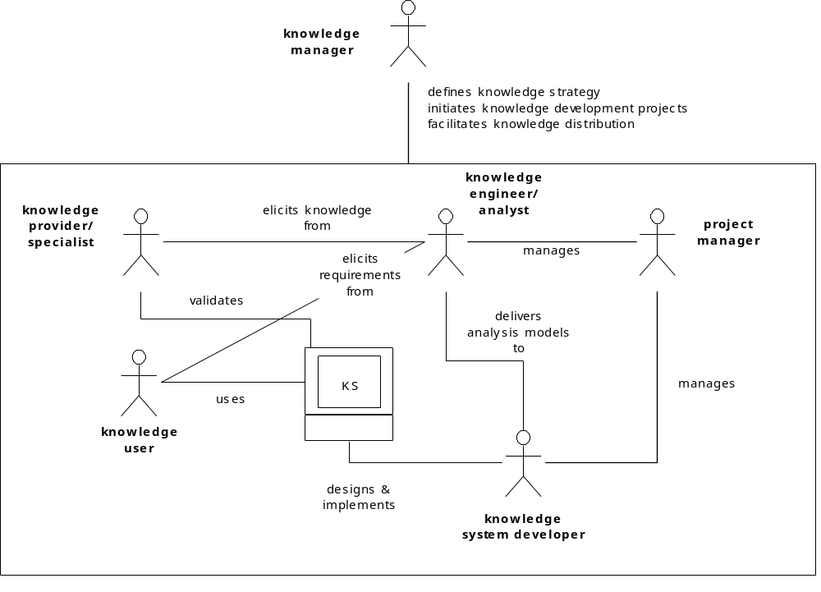
Knowledge-system development
UML Diagram
Knowledge Engineering - Natig Vahabov

Slide 63
References
Russell, Stuart; Norvig, Peter (1995). Artificial Intelligence: A Modern Approach
Kendal, S.L.; Creen, M. (2007), An introduction to knowledge engineering, London: Springer
Feigenbaum, Edward A. Knowledge engineering: the applied side of artificial intelligence. No. STAN-CS-80-812. STANFORD UNIV CA DEPT OF COMPUTER SCIENCE, 1980.
Schreiber, Guus, et al. "CommonKADS: A comprehensive methodology for KBS development." IEEE expert 9.6 (1994): 28-37.
Gourlay, Stephen. "The SECI model of knowledge creation: some empirical shortcomings."
Knowledge Engineering - Natig Vahabov

